Slide 1
You did it! 🥳🎉
TIP101
Notes:
🌟 Purpose: Congratulate students for completing the course and set a celebratory tone.
✅ What should I be doing?
Acknowledge students’ hard work and perseverance.
Build excitement for the session and celebrate their journey.
🎙️ What should I be saying?
Congratulations, everyone! You’ve reached the final session of TIP101! This is such an incredible accomplishment, and you should all feel proud of the effort and dedication you’ve put into this course.
Today, we’re going to celebrate, reflect on what we’ve achieved, and wrap up with a final round of collaborative problem-solving.
🙌🏽 How should I engage students?
Ask: "What’s one thing you’re most proud of accomplishing during TIP101?" Highlight a few responses to foster community and celebration.

Slide 2
1 | Welcome! 👋🏽 | 15 minutes
2 | Celebrate 🎉🎉🎉🎉🎉🎉 | 30 minutes
3 | BREAK | 5 minutes
4 | Collaborative Problem Solving | 60 minutes
5 | Wrap Up | 10 minutes
Notes:
🌟 Purpose: Provide a clear outline of the final session's activities.
✅ What should I be doing?
Review the schedule and set expectations for the flow of the session.
🎙️ What should I be saying?
Here’s what we have planned for our final session: We’ll start with a welcome and celebration, followed by a short break. Then, we’ll dive into one last round of collaborative problem-solving before wrapping up with reflections and final reminders.
🙌🏽 How should I engage students?
Pause and ask if anyone has questions about the agenda.

Slide 3
Welcome! 👋🏽
15 minutes

Slide 4


Turn on your cameras
Fill out the entry ticket
Notes:
🌟 Purpose: Encourage visual engagement to foster connection during the session.
✅ What should I be doing?
Prompt students to enable their cameras and submit the entry ticket.
🎙️ What should I be saying?
Let’s kick off our session by turning on our cameras!
Also, don’t forget to fill out the entry ticket to help us organize breakout rooms later.
🙌🏽 How should I engage students?
Use humor or compliments: "Let’s see those smiles!"
Acknowledge and thank students who turn on their cameras.

Slide 5
2 minutes
🥳Question:
We did it! Now that we have completed our semester, what will you guys be doing to celebrate before work/school begins again?
💬Answer:
Share your answer in the Zoom chat below. What kinds of pets do you have if any? If you don’t have any, share what type you would like to have, if any.

Slide 6

Announcements
Last class :’(
Let’s finish strong and make sure any remaining questions are closed.
Celebratory class, today we will take a breather and look back at our progress before our last breakout room session.

Slide 7
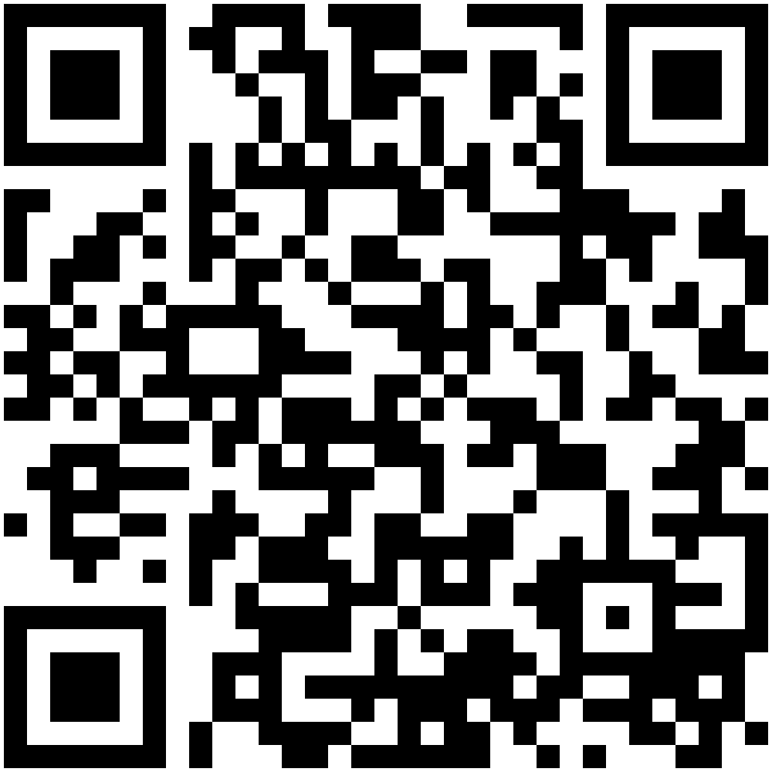
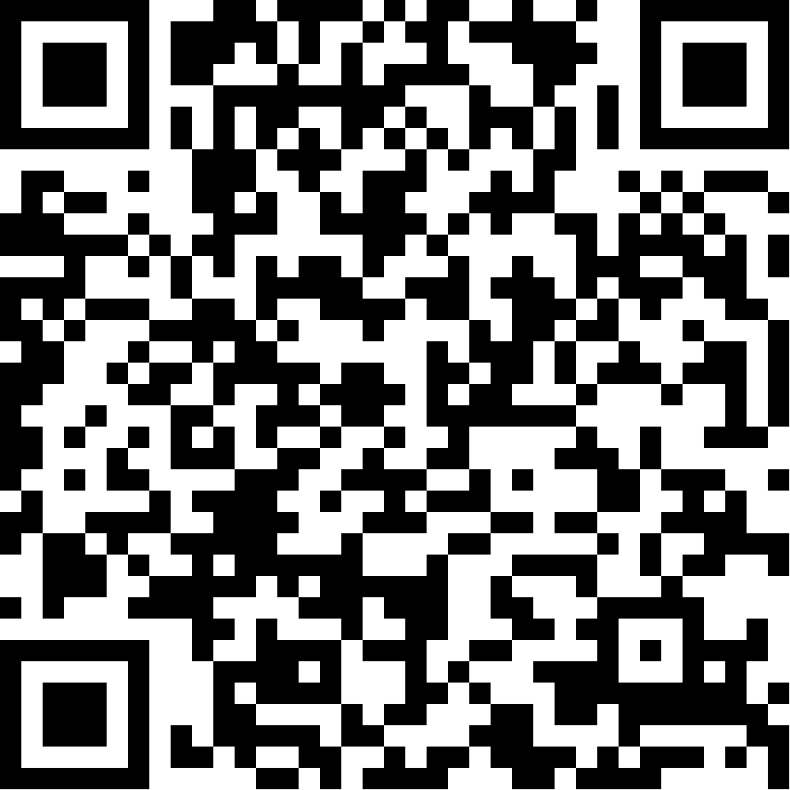
Interview practice with tech professionals
Limited spaces available!
Technical Interview Week August 17 - 20 Practice technical interview techniques and responses with experienced engineers
go.codepath.org/technical-interviews
QR code
Behavioral Interview Week August 24 - 27 1:1 mock behavioral interviews and feedback from tech professionals
go.codepath.org/behavioral-interviews
QR code
Don’t wait to sign up - popular timeslots fill quickly!
Notes:
I’d encourage you to take advantage of two upcoming opportunities to practice interviewing: Technical Interview Week and Behavioral Interview Week.
Each semester CodePath works with hundreds of tech professionals who volunteer their time to help you practice your interview skills - both behavioral and technical interviews.
You can sign up to take part in a 1:1 mock interview, followed by honest feedback and advice on where to improve.
It’s the best way to practice, grow your confidence, and also make a new professional contact. Definitely recommend signing up ASAP! Spots are limited and first come first served.

Slide 8
TF STAFFING IS OPEN · FALL 2026
CODEPATH*ORG
For Current Su26 students
Shortened application process for courses you’re taking (and passing) in Su26; app process validates your communication and teaching skills
SPECIAL PATH OPEN
HOW TO APPLY
Fill out our New TF Application
Current-student candidates will be considered on a rolling basis.
Apply before Aug 10th for greatest chance of securing a spot on our bench!
Aug 10
✓
✓
No technical pre-work for current course streams
The technical pre-work step is skipped on this path, for current courses.
✓
Finish your course
The special path may only apply once you become a completer.
Start your application →
Want to know more? We use a bench process - See the full role details on our Tech Fellow Wiki.

Slide 9
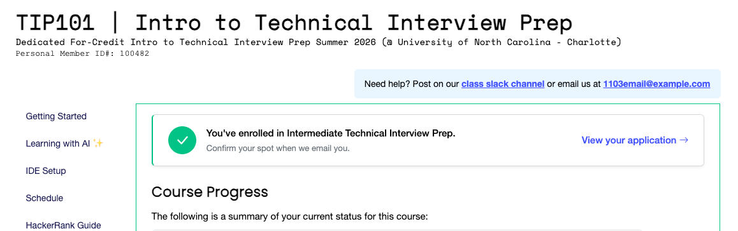
One Click Enroll - Join us in TIP 102!
STEP 01
STEP 02
STEP 03
Click Enroll
Confirm by email
Finish your course
On the green banner, either place (Student Hub or Course Portal).
We'll email you — click Confirm Enrollment .
Pass and finish as a completer.
Enrolled — you'll see this
A green check replaces the banner.
Notes:
Three steps. Click Enroll, then watch for our email and click Confirm Enrollment — that is the step people miss — and finish your course: pass and finish as a completer. Once the course ends, your application lives under Courses in the Student Hub, which is also where to find the button if you didn't apply during the course.

Slide 10
Fall 2026: Prework Party! 🎉
There’s still time to submit your prework for CodePath Fall 2026 courses. You’re invited to a Prework Submission Party - receive prework support and a gift card!
Join us virtually for our Prework Submission Party on Thursday, August 20 from 2–3 PM PT / 5–6 PM ET. Co-work on your prework with our ambassadors and other students.
Come unblock any questions you may have and maybe enjoy a snack on us! 👀
Get prework support at anytime via our prework support channel on Slack at prework-codepath.slack.com
Note: Upon completion (and passing) of your current course, this Fall you’ll be automatically qualified for the next course in your pathway, with no need to complete the prework! You’re still encouraged to attend if you’ve applied to other courses.
📌 Register Here

Slide 11
30 minutes
Celebrate! 🎉🎉🎉🎉

Slide 12
Looking back through what we’ve completed
Estimated 3,500+ Breakout Room Problems solved
Almost 4,000 session feedback responses
Some students met up to ~35+ new classmates throughout the semester
We completed ~500+ mock interviews
We completed 4,000+ HackerRank assignments
Notes:
🌟 Purpose: Create a collaborative and reflective space to celebrate individual and group accomplishments.
✅ What should I be doing?
Facilitate a celebratory activity where students share their achievements and add them to a showcase (e.g., Padlet or chat).
🎙️ What should I be saying?
It’s time to celebrate! Break into your groups and share something you’re proud of—whether it’s a new skill, a challenge you overcame, or a milestone you reached in this course.
Let’s also contribute to the Accomplishments Showcase. Add your highlights, shout-outs, or inspirational messages. Think of this as a virtual trophy wall!
I’ve shared the link to our showcase in the chat. Take a moment to add your contributions now.
🙌🏽 How should I engage students?
Encourage sharing by giving examples: "I’m proud of how engaged you’ve been in solving problems as a group—what’s something you’re proud of?"
Acknowledge specific contributions in the showcase and thank students for their participation.

Slide 13
Looking back through your feedback
“Breakout room” mentioned 747 times
“Meeting new people” mentioned 386 times
“Mock interviews” mentioned 128 times
Initial concerns dropped by 50% by week 5
Week (3-4) was the lowest confidence timeframe as we adjusted
Weeks (5-8) showed that students are more confident despite harder topics!
Students mentioned each other by name 4,200+ times!
534 Tech Fellow & ops team (Kenneth) mentions !!
18 TFs mentioned by name in our section, shoutouts:
Neel, Justin, Leanna, Angela, Eddie, La’Joir
Notes:
🌟 Purpose: Create a collaborative and reflective space to celebrate individual and group accomplishments.
✅ What should I be doing?
Facilitate a celebratory activity where students share their achievements and add them to a showcase (e.g., Padlet or chat).
🎙️ What should I be saying?
It’s time to celebrate! Break into your groups and share something you’re proud of—whether it’s a new skill, a challenge you overcame, or a milestone you reached in this course.
Let’s also contribute to the Accomplishments Showcase. Add your highlights, shout-outs, or inspirational messages. Think of this as a virtual trophy wall!
I’ve shared the link to our showcase in the chat. Take a moment to add your contributions now.
🙌🏽 How should I engage students?
Encourage sharing by giving examples: "I’m proud of how engaged you’ve been in solving problems as a group—what’s something you’re proud of?"
Acknowledge specific contributions in the showcase and thank students for their participation.

Slide 14
Looking back at what we’ve learned
Over these last 10 weeks, we have covered so many new topics. Regardless of your background, you got to improve on:
Big-O
Dictionaries
String operations / string manipulation
Two pointers
OOP
linked lists techniques (temporary head, two pointers)
Binary search on sorted lists
Recursion
Binary trees vs. Binary search trees
Tree traversal techniques
Mock interviews / problem-solving strategy (UMPIRE)
Notes:
🌟 Purpose: Create a collaborative and reflective space to celebrate individual and group accomplishments.
✅ What should I be doing?
Facilitate a celebratory activity where students share their achievements and add them to a showcase (e.g., Padlet or chat).
🎙️ What should I be saying?
It’s time to celebrate! Break into your groups and share something you’re proud of—whether it’s a new skill, a challenge you overcame, or a milestone you reached in this course.
Let’s also contribute to the Accomplishments Showcase. Add your highlights, shout-outs, or inspirational messages. Think of this as a virtual trophy wall!
I’ve shared the link to our showcase in the chat. Take a moment to add your contributions now.
🙌🏽 How should I engage students?
Encourage sharing by giving examples: "I’m proud of how engaged you’ve been in solving problems as a group—what’s something you’re proud of?"
Acknowledge specific contributions in the showcase and thank students for their participation.

Slide 15
Looking back . . . KAHOOT 🤩
The purpose of the course isn’t to memorize everything right away, but just to make continuous progress. Let’s do a quick Kahoot game to see how well we can recall the information! The winners of the Kahoot will get:
1st place 🥇:
Resume review, LinkedIn Review + endorsement and 1:1 Mock Interview with me
2nd place 🥈:
Resume review and LinkedIn Review + endorsement
3rd Place 🥉:
Resume review
Notes:
🌟 Purpose: Create a collaborative and reflective space to celebrate individual and group accomplishments.
✅ What should I be doing?
Facilitate a celebratory activity where students share their achievements and add them to a showcase (e.g., Padlet or chat).
🎙️ What should I be saying?
It’s time to celebrate! Break into your groups and share something you’re proud of—whether it’s a new skill, a challenge you overcame, or a milestone you reached in this course.
Let’s also contribute to the Accomplishments Showcase. Add your highlights, shout-outs, or inspirational messages. Think of this as a virtual trophy wall!
I’ve shared the link to our showcase in the chat. Take a moment to add your contributions now.
🙌🏽 How should I engage students?
Encourage sharing by giving examples: "I’m proud of how engaged you’ve been in solving problems as a group—what’s something you’re proud of?"
Acknowledge specific contributions in the showcase and thank students for their participation.

Slide 16

Let’s take 5 min to write down our thoughts . . .
Share something you are proud of from the course, such as a skill you developed or a challenge you overcame.
Then add to the Padlet! This can be:
Highlights
Shout-outs
Favorite memories
Inspirational messages or quotes
General thoughts or feelings
Feel free to include a gif/pic!
Notes:
🌟 Purpose: Create a collaborative and reflective space to celebrate individual and group accomplishments.
✅ What should I be doing?
Facilitate a celebratory activity where students share their achievements and add them to a showcase (e.g., Padlet or chat).
🎙️ What should I be saying?
It’s time to celebrate! Break into your groups and share something you’re proud of—whether it’s a new skill, a challenge you overcame, or a milestone you reached in this course.
Let’s also contribute to the Accomplishments Showcase. Add your highlights, shout-outs, or inspirational messages. Think of this as a virtual trophy wall!
I’ve shared the link to our showcase in the chat. Take a moment to add your contributions now.
🙌🏽 How should I engage students?
Encourage sharing by giving examples: "I’m proud of how engaged you’ve been in solving problems as a group—what’s something you’re proud of?"
Acknowledge specific contributions in the showcase and thank students for their participation.

Slide 17
Break Time!
Take 5 mins to step away from the computer. Feel free to turn off your camera and return promptly after 5 mins.
Notes:
🌟 Purpose: Provide a short break to refresh and re-energize.
✅ What should I be doing?
Announce the break and remind students to return on time.
Play the countdown timer video (be sure to share sound).
🎙️ What should I be saying?
Let’s take 5 minutes to step away from the screen. Be sure to return promptly.

Slide 18
Collaborative Problem Solving
60 minutes

Slide 19
60 minutes
🏃🏽 Navigate to your breakout room.
👋🏽 Introduce yourselves!
🧑🏽‍💻 Work on the problems for your selected unit.

Slide 20
Wrap Up + Class Pic
10 minutes

Slide 21
Notes:
🌟 Purpose: End the session on a positive note.
✅ What should I be doing?
Prompt students to share their reflections in the chat.
🎙️ What should I be saying?
Let’s celebrate your wins. Share one good thing you learned or accomplished today!
🙌🏽 How should I engage students?
Read a few responses aloud and celebrate with enthusiasm.

Slide 22


End of Course Survey Time!
7 min for End of Course Survey
Check your email for the link
Notes:
🌟 Purpose: Gather feedback to improve future sessions.
✅ What should I be doing?
Share the survey link and emphasize its importance.
🎙️ What should I be saying?
Your feedback helps us make these sessions even better. Please take a moment to complete the survey.
🙌🏽 How should I engage students?
Thank students for their input and explain how feedback has been used in the past.

Slide 23

Final Reminders
Finish the problem sets for additional practice
Your final HackerRank assessment is due by Sunday @ midnight
Visit a Study Hall Session to deepen your understanding, work through challenges, and connect with course material alongside your peers!
Sign-Up for Future Opportunities!
Interview Prep sessions
Interested in being a Tech Fellow? Start your application
Enrolling in your next class? Check out Fast Track Enrollment
Check out other courses: codepath.org/courses
Register for our Prework Party!
Notes:
🌟 Purpose: Reinforce key tasks and deadlines.
✅ What should I be doing?
Summarize next steps and encourage continued engagement.
🎙️ What should I be saying?
Don’t forget to complete the problem sets and take the HackerRank assessment by Sunday!
🙌🏽 How should I engage students?
Encourage students to ask any lingering questions before signing off.

Slide 24
Final Reminders
YOU GOT THIS!! You all have done a wonderful job at:
Showing up 📍
Solving difficult problems 😤
Collaborating 🤝
Creating a fun environment 💃🥳🕺
Wishing you all the best of luck!!
Notes:
🌟 Purpose: Reinforce key tasks and deadlines.
✅ What should I be doing?
Summarize next steps and encourage continued engagement.
🎙️ What should I be saying?
Don’t forget to complete the problem sets and take the HackerRank assessment by Sunday!
🙌🏽 How should I engage students?
Encourage students to ask any lingering questions before signing off.

Slide 25
Let’s close out with a pic!
Notes:
🌟 Purpose: Congratulate students for completing the course and set a celebratory tone.
✅ What should I be doing?
Acknowledge students’ hard work and perseverance.
Build excitement for the session and celebrate their journey.
🎙️ What should I be saying?
Congratulations, everyone! You’ve reached the final session of TIP101! This is such an incredible accomplishment, and you should all feel proud of the effort and dedication you’ve put into this course.
Today, we’re going to celebrate, reflect on what we’ve achieved, and wrap up with a final round of collaborative problem-solving.
🙌🏽 How should I engage students?
Ask: "What’s one thing you’re most proud of accomplishing during TIP101?" Highlight a few responses to foster community and celebration.

